Slide 1
Chapter 6 Semantic Analysis

Slide 2
Semantic Analysis
Purpose: compute additional information needed for compilation that is beyond the capabilities of context-free grammars and standard parsing algorithms;
Static semantic analysis: Take place prior to execution (Such as building a symbol table、performing type inference and type checking) ;
语义分析包括构造符号表、记录声明中建立的名字的含义、在表达式和语句中进行类型推断和类型检查以及在语言的类型规则作用域内判断它们的正确性。

Slide 3
Semantic Analysis
Static semantic analysis involves both the description of the analyses to perform and the implementation of the analyses using appropriate algorithms. It is similar to lexical and syntactic analysis. In syntactic analysis, for example, we used context-free grammars in Backus-Naus Farm (BNF) to describe the syntax and various top-down and bottom-up parsing algorithms to implement the syntax. In semantic analysis, the situation is not as clear, partially because there is no standard method (like BNF) used to specify the static semantics of a language and partially because the amount and kind of static semantic analysis varies so widely from language to language.
One method of describing semantic analysis that is frequently used to good effect by compiler writers is to identify attributes, or properties of language entities that must be computed and to write attribute equations, or semantic rules, that express how the computation of such attributes is related to the grammar rules of the language. Such a set of attributes and equations is called an attribute grammar. Attribute grammars are most useful for languages that obey the principle of syntax-directed semantics, which asserts that the semantic content of a program is closely related to its syntax. All modern languages have this property. Unfortunately, the compiler writer must usually construct an attribute by hand.

Slide 4
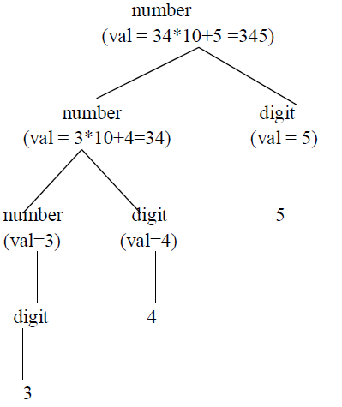
Semantic Analysis
Description of the static semantic analysis:
attribute grammar (identify attributes of language entities that must be computed and to write attribute equations or semantic rules that express how the computation of such attributes is related to the grammar rules of the language. ) which is most useful for languages that obey the principle of syntax-directed semantics.
Abstract syntax as represented by an abstract syntax tree.

Slide 5
6.1 Attributes and attribute grammars
Attributes: any property of a programming language construct such as
The data type of a variable
The value of an expression
The location of a variable in memory
The object code of a procedure
The number of significant digits in a number
可以在复杂的处理(甚至编译程序的构造)之前确定属性。例如，一个数的有效位数可以根据语言的定义确定(或者至少给出一个最小值)。属性也可以在程序执行期间才确定，如(非常数)表达式的值，或者动态分配的数据结构的位置。

Slide 6
6.1 Attributes and attribute grammars
Binding of the attribute: the process of computing an attribute and associating its computed value with the language construct in question. 属性的计算及将计算值与正在讨论的语言结构联系的过程称作属性的联编( binding )。
Binding time: the time during the compilation/execution process when the binding of an attribute occurs.
Based on the difference of the binding time, attributes are divided into Static attributes (be bound prior to execution) and Dynamic attributes (be bound during execution).

Slide 7
6.1 Attributes and attribute grammars
Example: the binding time and significance during compilation of the attributes. Attribute computations are extremely varied.
type checker: In a language like C or Pascal, is an important part of semantic analysis; while in a language like LISP, data types are dynamic, LISP compiler must generate code to compute types and perform type checking during program execution.
the values of expressions: usually dynamic and the be computed during execution; but sometime can also be evaluated during compilation (constant folding).
The allocation of a variable: either static (such as in FORTRAN77) or dynamic (such as in LISP), sometimes it is a mixture of static and dynamic (such as in C and Pascal) depending on the language and properties of the variable itself.
Object code of a procedure: a static attribute, which is computed by the code generator.
Number of significant digits in a number: often not explicitly treated during compilation.

Slide 8
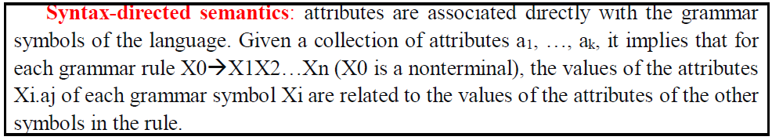
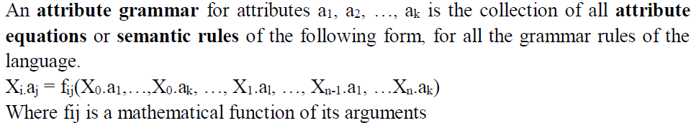
6.1.1 Attribute grammars
X.a means the value of a associated to X (X is a grammar symbol and a is an attribute associated to X).

Slide 9
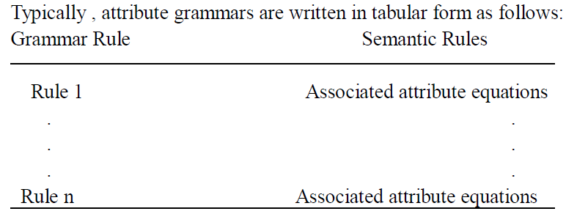
6.1.1 Attribute grammars

Slide 10
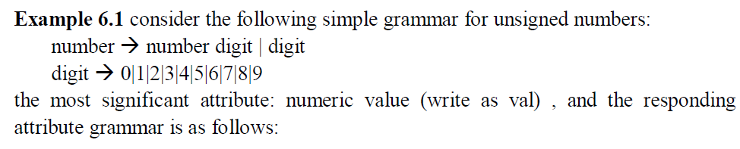
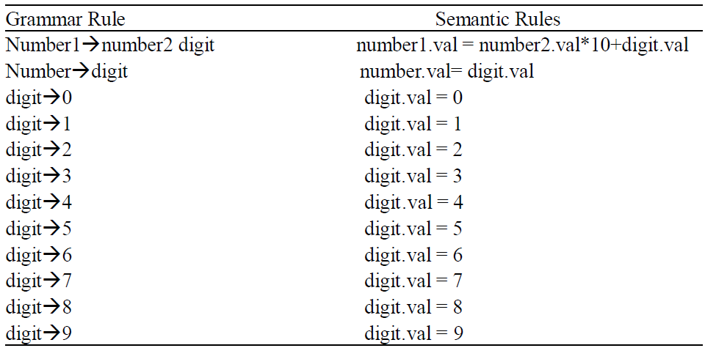

Slide 11
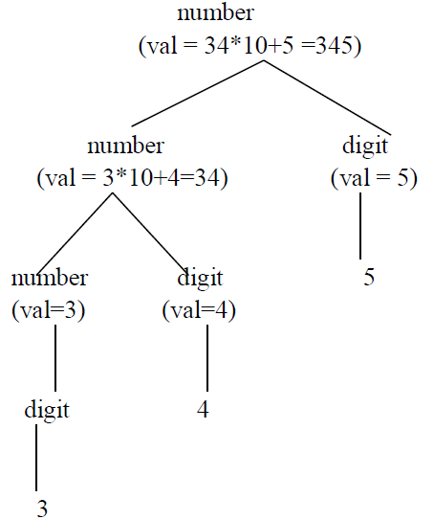
the parse tree showing attribute computations for the number 345 is given as follows
使用字符串的语法树可以形象化地表示特殊字符串的属性等式的意义

Slide 12
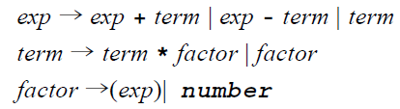
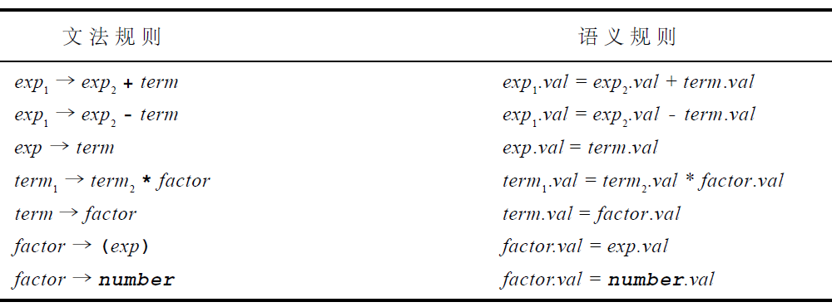

Slide 13
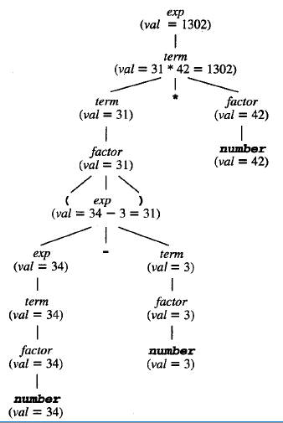
通过在语法树的节点上附加等式来表示属性文法包含的计算。例如，给定表达式(34-3) * 42，可以用在其语法树上值的语义来表达，如图6 - 2所示。

Slide 14
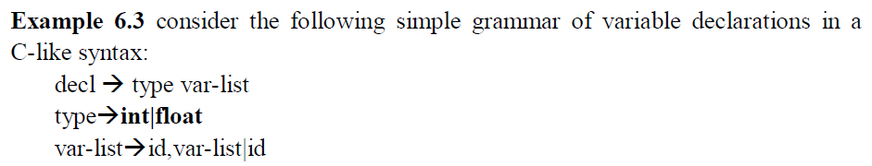
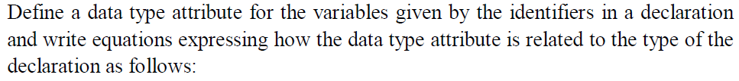
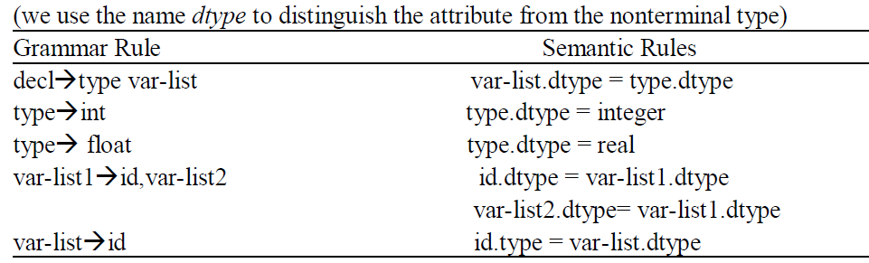

Slide 15
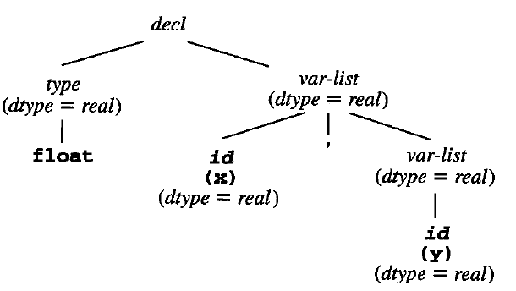
Note that there is no equation involving the dtype of the nonterminal decl. It is not necessary for the value of an attribute to be specified for all grammar symbols.
Parse tree for the string float x,y showing the dtype attribute as specified by the attribute grammar above is as follows:

Slide 16
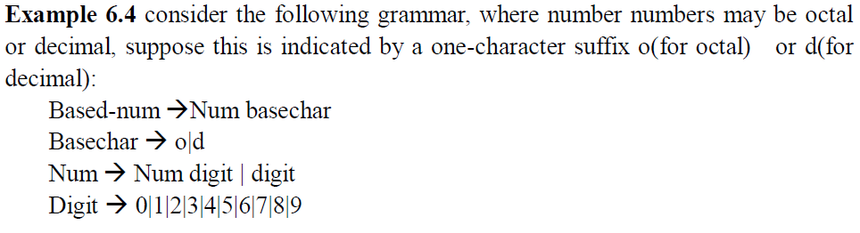
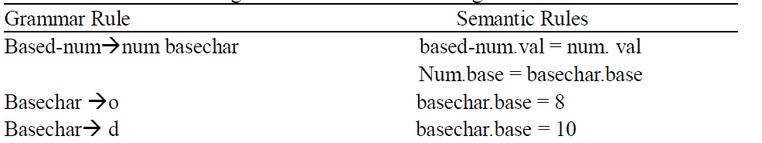

Slide 17
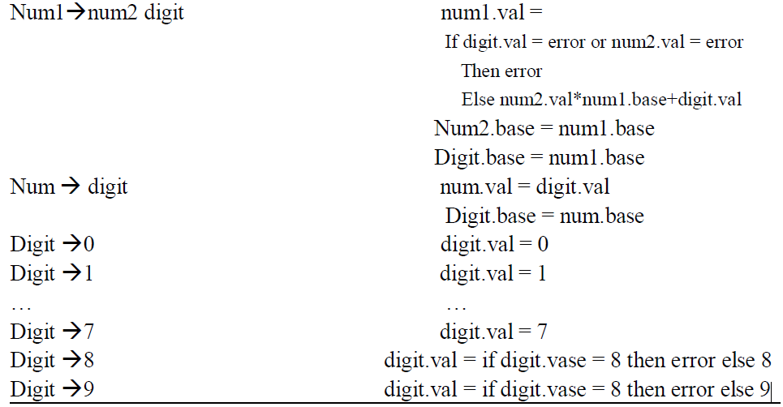

Slide 18
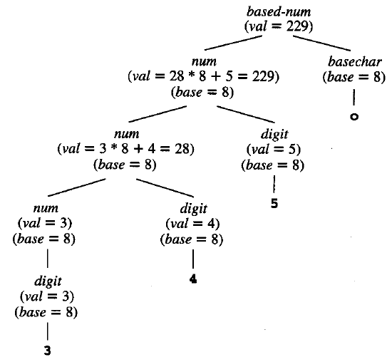
在这个属性文法中必须注意两个新的特性。首先，这个B N F文法在后缀为o时自己不能排除错误的(非八进制)数字8和9的组合。例如，按照上面的B N F文法，字符串189o在语法上是

Slide 19
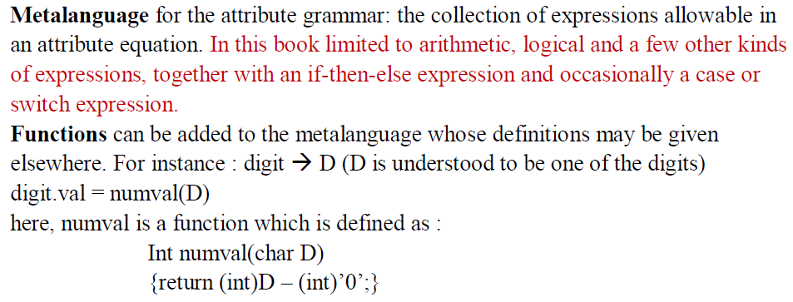
6.1.2 Simplifications and Extensions to Attribute Grammars

Slide 20
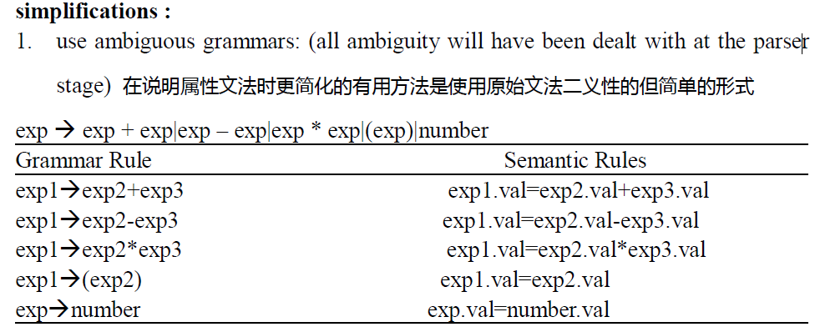
6.1.2 Simplifications and Extensions to Attribute Grammars

Slide 21
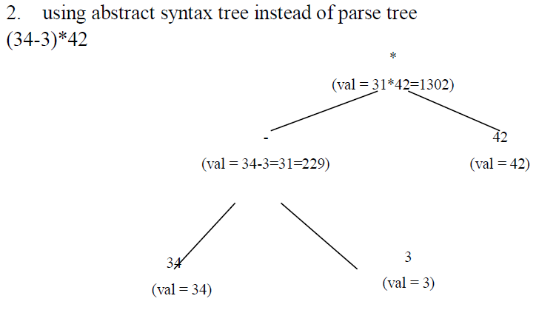
6.1.2 Simplifications and Extensions to Attribute Grammars

Slide 22
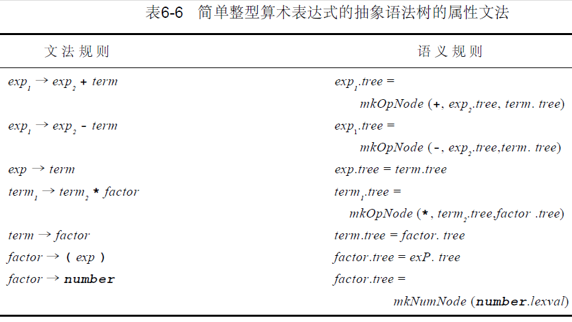
6.1.2 Simplifications and Extensions to Attribute Grammars

Slide 23
6.2 Algorithms for attribute computation
Purpose: study the ways an attribute grammar can be used as basis for a compiler to compute and use the attributes defined by the equations of the attribute grammar.
Attribute equations is turned into computation rules
X_{i.}a_{j} = f_{ij}(X₀.a₁,…,X₀.a_{k}, …, X₁.a_{l}, …, X_{n-1}.a₁, …X_{n}.a_{k})
is viewed as an assignment of the value of the functional expression on the right- hand side to the attribute X_{i.}a_{j.}
The attribute equations indicate the order constraints on the computation of the attributes. Attribute at the right-hand side must be computed before that at the left-hand side. The constraints is represented by directed graphs — dependency graphs.

Slide 24
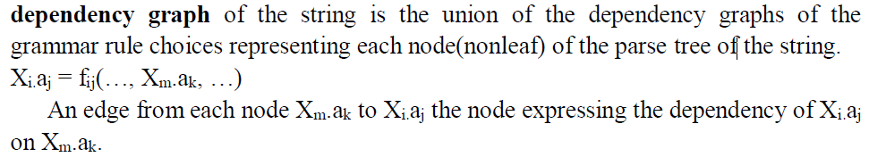
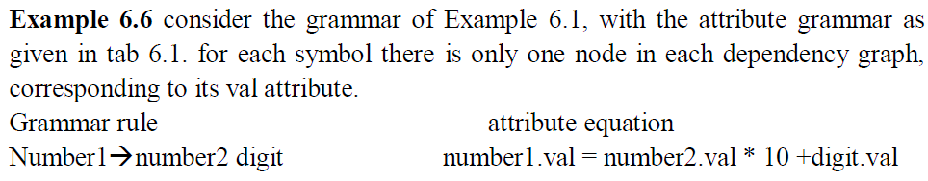
6.2.1dependency graphs and evaluation order

Slide 25
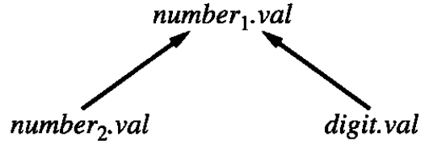
6.2.1dependency graphs and evaluation order

Slide 26

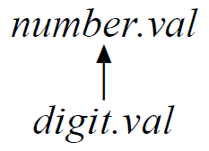
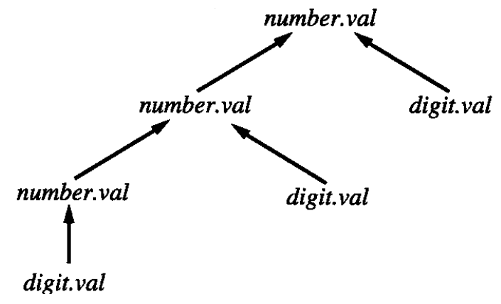
6.2.1dependency graphs and evaluation order

Slide 27

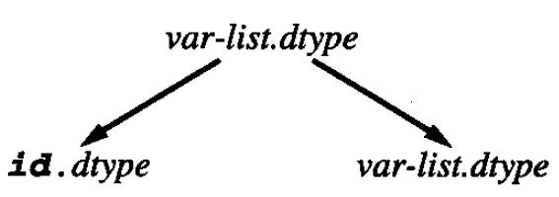
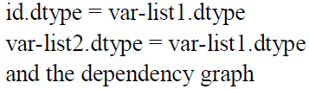
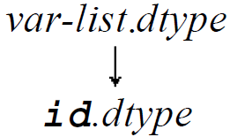
6.2.1dependency graphs and evaluation order

Slide 28

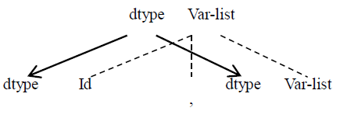

6.2.1dependency graphs and evaluation order
In this case, since decl is not directly involved in the dependency graph, it is not completely clear which grammar rule has this graph associated to it. For this reason (and after other reasons that we discuss later), we often draw the dependency graph superimposed over a parse tree segment corresponding to the grammar rule. Thus, the above dependency graph can be drawn as

Slide 29
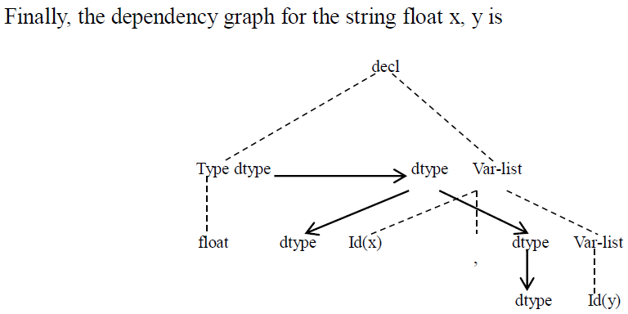
6.2.1dependency graphs and evaluation order

Slide 30



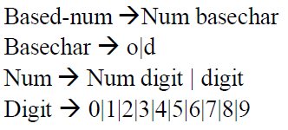
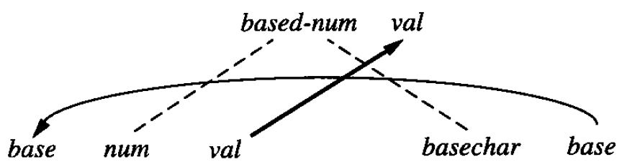
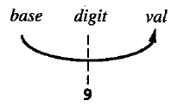
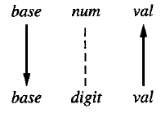

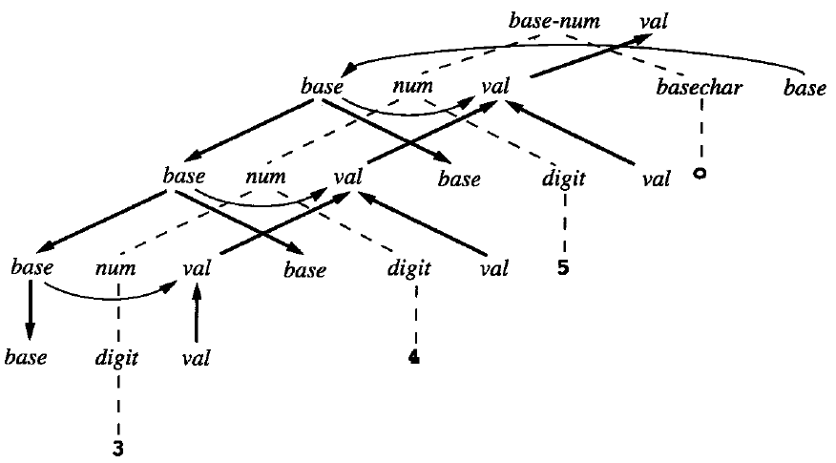

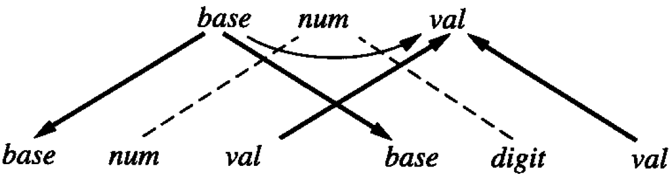
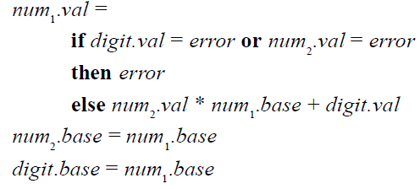

Slide 31
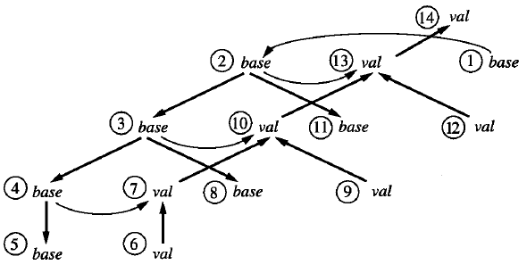
6.2.1dependency graphs and evaluation order
Any algorithm must compute the attribute at each node in the dependency graph before it attempts to compute any successor attributes. a traversal order of the dependency graph that obeys this restriction is called a topological sort, which requires that the graph must be acyclic, such graphs are called directed acyclic graphs. Or DAGs.
给定要转换的一个特定的记号字符串，字符串语法树的相关图根据计算字符串属性的算法给出了一系列顺序约束。

Slide 32
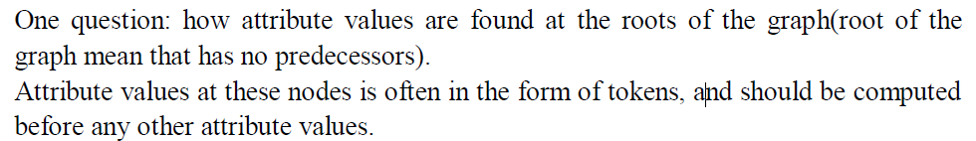
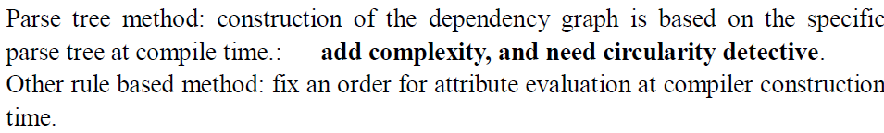
6.2.1dependency graphs and evaluation order

Slide 33

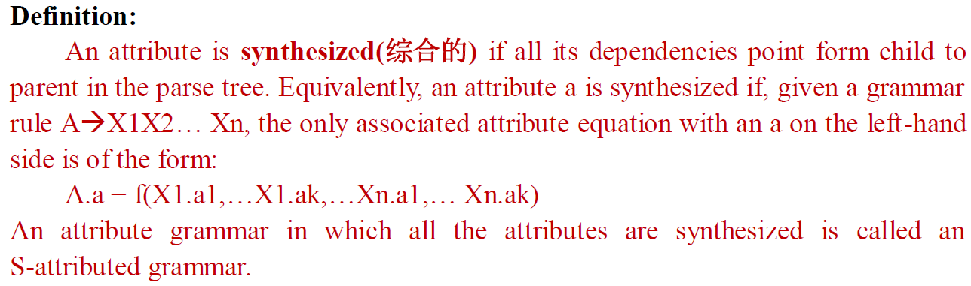
6.2.2 Synthesized and inherited attributes

Slide 34
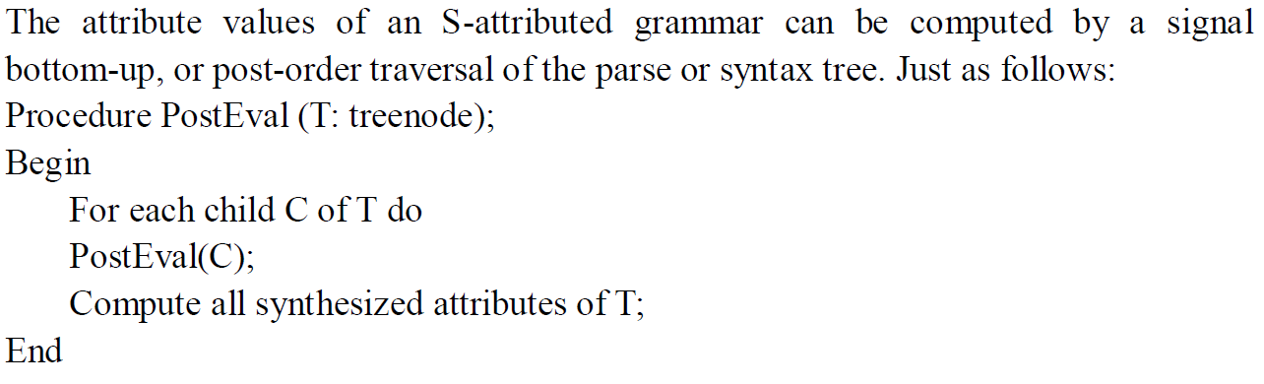
6.2.2 Synthesized and inherited attributes

Slide 35
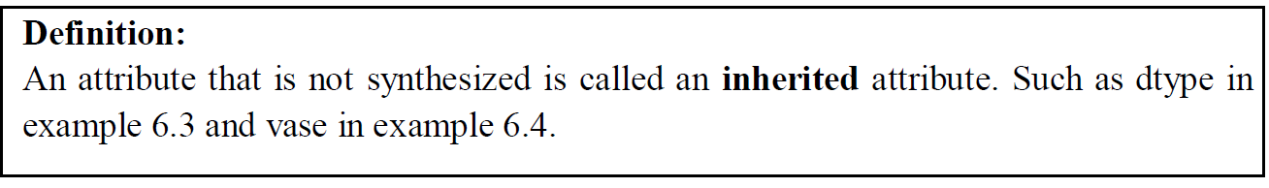
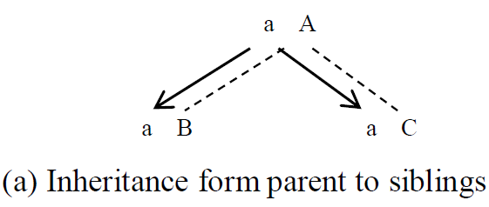
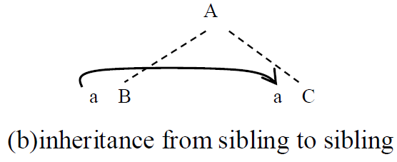
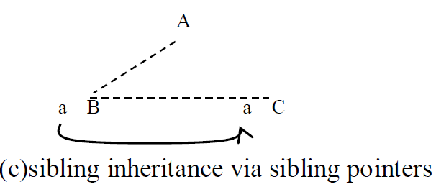
6.2.2 Synthesized and inherited attributes

Slide 36
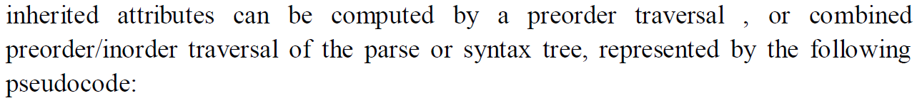
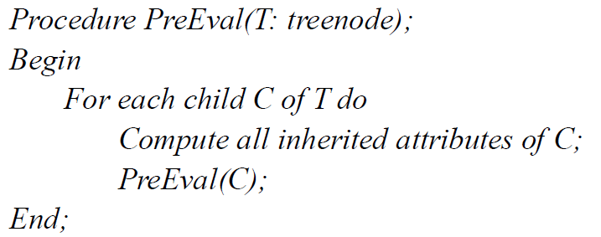

6.2.2 Synthesized and inherited attributes

Slide 37



Slide 38


